Slide 1
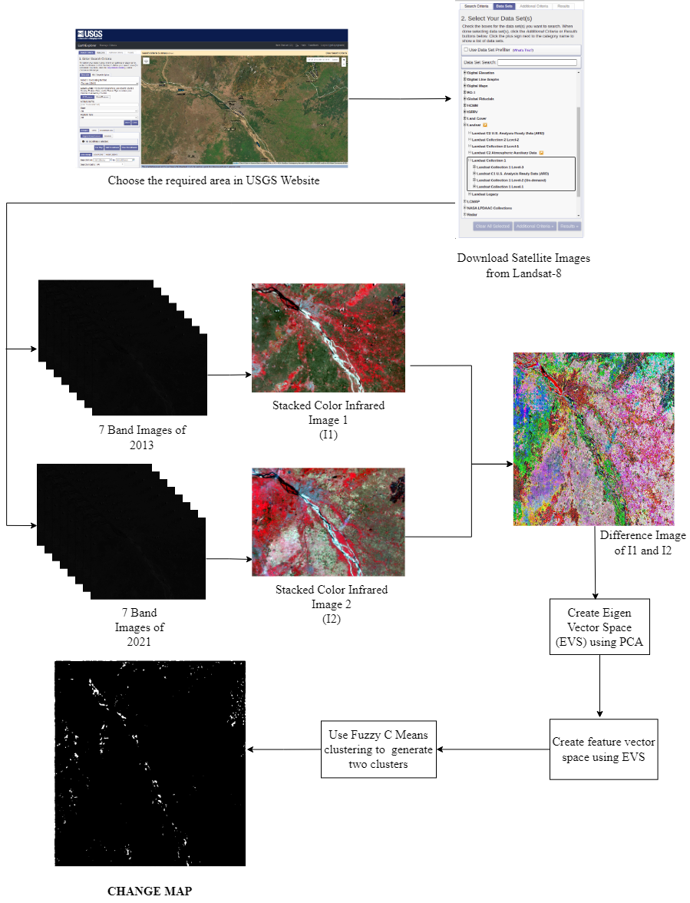
ARCHITECTURE

